Slide 1


CALPADS EOY Primer
Preparation for the End of Year data Collection

Slide 2




Objective
Identify
Submit
Provide
Take
the key dates, milestones and timeline of the End of Year Submissions
Project Management
data in advance of the data collection window through an understanding of operational keys and processing methods
Manage & Maintain Data
information using report data early in the submission window to encourage investment and cooperation during the EOY Data collection
Coalition Building
advantage of the training resources to educate staff of requirements and functionality
Critical Thinking

Slide 3

Agenda
Overview
EOY 1
EOY 2
Reminders
Wrap-Up

Slide 4

EOY Overview
Discuss background of EOY submissions

Slide 5
New Consolidated EOY Data Collections
EOY 1
July 1–June 30
EOY 2
July 1–June 30
Grades 7-12
Program Eligibility
Homeless Program
Course Completion
Expanded Learning Programs
CTE participants and Completers
RFEP
Student Behavioral Incidents
Work-Based Learning
Student Absence Summary
Grads and Completers
Cumulative Enrollment
Special Education
Postsecondary Outcomes for SWD

Slide 6

Quick Reminders
The EOY Data Collections begin on May 5th, this is when revisions and reports become available
The EOY 1 certification deadline is July 17 with a Final deadline of July 31 (SELPA Approval Required)
The EOY 2 Final certification deadline is August 17 – No amendment window
The graduation cohort cut-off date is August 15th
This means, the EOY deadline and the pull of data for the cohort have been “de-coupled”
As a result, there may be a slight difference between the certified count of graduate and completers and those included in the 4-year ACGR

Slide 7
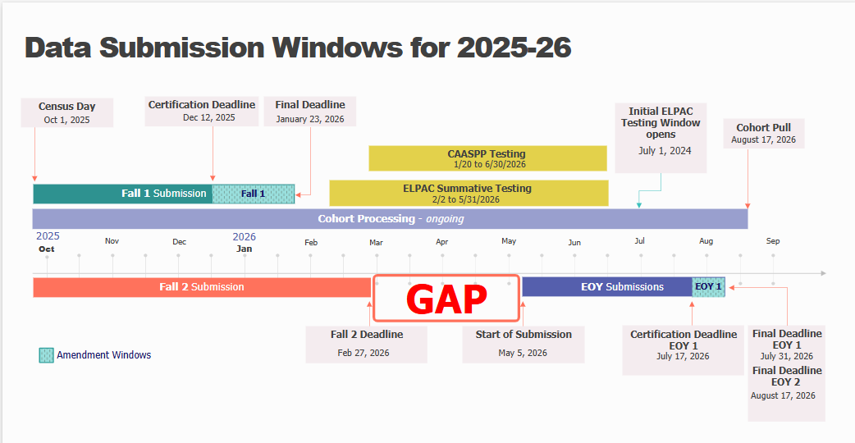

Slide 8
Certification Process
EOY 1 has TWO levels of approval
EOY 2 has ONE level of approval
EOY Primer v1.0 AY 2023-24

Slide 9

EOY 1
Program Eligibility, Expanded Learning Programs, Behavioral Incidents, Cumulative Enrollment, Absenteeism, RFEP, Homeless, SPED, Post Secondary Outcomes for SWD

Slide 10
EOY 1 Data Collection
Data Submitted
Files Submitted
HOMELESS STUDENTS (SPRG)
EXPANDED LEARNING (LEAP)
STUDENT PROGRAM (SPRG)
Program
CARS
Student subgroups
Schoolwide programs
Homeless
Subgroup data
Stability Report
Expanded Learning Program
SCHOOLWIDE PROGRAM
Site Staff
Program staff
Site Administrators
Student System Support Staff
Staff Involved with Submission

Slide 11
EOY 1 Pre-snapshot Submission Activities
Record Type | Activity | Reasoning | Processing Method | Record Operational Keys
SPRG | Ongoing | Program data should be updated as students start and end participation with a particular school. Most records should have been submitted prior to the EOY submission. Certify the schoolwide status in CARS Homeless student data should be verified annually and updated when the student is rehoused | Transaction | School of Attendance SSID Education Program Code Education Program Membership Start Date Education Service Academic Year Education Service Code

Slide 12

Homeless Students
CALPADS administrators should coordinate with their local homeless liaisons to identify homeless students
LEAs should submit a Student Program (SPRG) record reflecting an Education Program Code of 191 – Homeless Program
EOY cumulative homeless counts are the basis for federal funding
Update your data in CALPADS as frequently as possible to help county and state liaisons better plan and provide support to districts experiencing significant increases in homeless student enrollment

Slide 13
New EOY 1 Fatal Validations Homeless Program Annual Close-Out
Rule | Type | Error Message | Error Description
SPRG0746E1 | EOY1 DD/CDD | Homeless Education Membership End Date is Missing | Homeless records (Education Program Code 191) must be closed within same Academic Year (July 1–June 30) starting AY 2025-26
SPRG0747E1 | EOY1 DD/CDD | Homeless Education Membership End Date is Missing Homeless Education Membership End Date is Missing | Homeless records (Education Program Code 191) opened prior to 2025-26 must be closed out with end date of 6/30/2025 or prior.
SPRG0747 | INPUT |  | Homeless records (Education Program Code 191) opened prior to 2025-26 must be closed out with end date of 6/30/2025 or prior.
Supports annual redetermination and improves the accuracy of homeless data
Once 25/26 EOY closes, CALPADS will auto close all remaining open homeless records
EOY Primer v1.0 AY 2023-24

Slide 14

New 25-26 Expanded Learning Programs
Report via new LEA level file –LEAP
Submit Program Code 194 – Expanded Learning Programs
Report Expanded Learning Program Days (0+ days attended) during AY July 1-June 30
There is not a specific amount of time students must attend an ELP to be counted as a day of attendance in an ELP program
Include all enrolled students (signed registration form on file) regardless if the student participated in or attended ELP.
If a student enrolled in an ELP and never attended an ELP program, the LEA should populate this field with “0.”

Slide 15
EOY 1 Data Collection
Student Incident (SINC)
Files Submitted
Student Incident Results (SIRS)
Student Offense (SOFF)
Student Absenteeism (STAS)
RFEP (SELA)
Cumulative Enrollment (SENR)
Data Submitted
Incidents
Absence Summary
RFEP
Cumulative Enrollment
State Indicator
UMIRS
State indicator
Suspension Rate
Absenteeism Rate
Subgroup Data
IDEA
Attendance Recovery Days
Site Administrators
Staff Involved with Submission
District Administrators
EL Coordinator
Special Ed staff
Attendance Clerks
Attendance Supervisor
NPS School Staff

Slide 16
EOY 1 Pre-snapshot Submission Activities
Record Type | Activity | Reasoning | Processing Method | Record Operational Keys
SENR | Ongoing | Enrollments records are used to determine cumulative enrollments and every student should be exited by the end of the AY | Transaction | School of Attendance SSID Enrollment Start Date
SELA | Ongoing | Reclassified EL students should have their status updated withing an enrollment period | Transaction | Effective Start Date SSID

Slide 17
More Pre-snapshot Submission Activities
Record Type | Activity | Reasoning | Processing Method | Record Operational Keys
STAS | End of Year | Stas is calculated from attendance. Students may need exit dates to extract the data | Replacement | School of Attendance Academic Year ID SSID
SINC | Now | SINC, SIRS and SOFF must be posted in succession and completely, but there is benefit to submitting them prior to school ending to resolve the majority of errors that may arise. Files submission can be completed by school if schools have different end dates or by incident if Q allows for only new incidents to be extracted | Replacement | School of Attendance Academic Year ID Incident ID Local
SIRS | Now |  | Replacement | School of Attendance Academic Year ID Incident Local ID
SOFF | Now |  | Replacement | School of Attendance Academic Year ID Incident ID Local
EOY Primer v1.0 AY 2023-24

Slide 18

NPS School Incident Reporting
LEAs and NPS schools must have policies and procedures in place to identify, document, and report incidents involving restraint and seclusion for students with disabilities
LEAs have the burden of submission, therefore must facilitate data collection and verify completeness prior to submission

Slide 19

Reclassifying English Learners
Review 2024-2025 Summative Scores for Reclassification in 2025-2026
After May 31,2026 , 2024-2025 ELPAC and Summative Alternate ELPAC scores can no longer be used for reclassification purposes in 2025-2026
Reclassify students and Upload to CALPADS by May 15, 2026
Ensure students transferring have updated records in CALPADS within 10 days
Routinely review SERN0657E1 for TBD students who have not been tested in 30 days.
Use Data Discrepancy functionality throughout the year to identity students with ELAS of TBD who have no been assessed within the 30 day window

Slide 20

Long-Term English Learners
Continuing with the LTEL data implementation from last year, this phase will improve reports by adding
A LTEL Indicator filter (Y/N) to reports:
1.21 – Cumulative Enrollment – Counts, C/A 1.21 Cumulative Enrollment – Counts, 8.1 – Student Profile List (EOY)
An EL Enrollment Indicator, EL Status Start Date, Long-Term English Learner Indicator , LTEL Start Date, Initial US School Enrollment Date K-12, Earliest SENR Enrollment Start Date, Earliest EL Status Start Date columns (similar to data on CENR extract) to report 8.1(EOY)

Slide 21
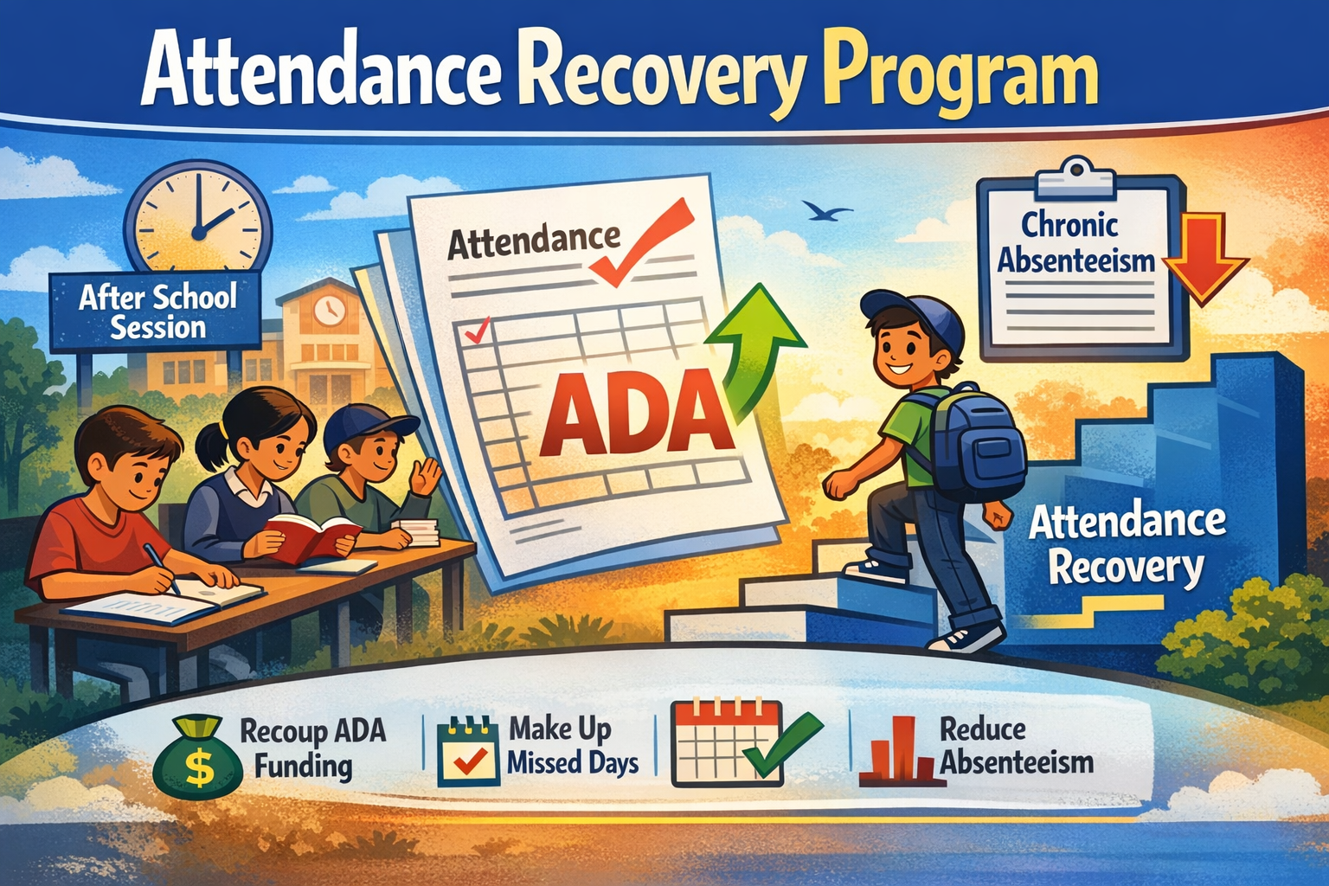
NEW 25-26 Attendance Recovery Program
AR is an optional program for students in grades TK–12
Allows students to recoup absences for ADA apportionment
AR sessions must be held outside the regular school day and meet all statutory criteria
Helps LEAs recover ADA
Supports efforts to reduce chronic absenteeism
CALPADS will collect number of AR days earned on the Student Absence Summary (STAS) file
All other STAS fields remain unchanged
Absence counts must NOT be adjusted based on AR days
AR days are reported in addition to existing absence data—not as replacements
Visit the CDE Attendance Recovery page for FAQs and details: https://www.cde.ca.gov/fg/it/aarecovery.asp

Slide 22
EOY 1 Data Collection
SWD Status (SWDS)
Files Submitted
Post Secondary Status (PSTS)
SWD Meetings (MEET)
SWD Plan (PLAN)
SWD Services (SERV)
Data Submitted
Special Education
Postsecondary status
Nonparticipation
Eligibility/Participation status
SWD Status
Nonparticipation reason
Plans and Program settings
Statutory Meetings
Exit Reason, Completion status
Employment and educational status
Site Staff
Staff Involved with Submission
Special Ed staff
Site Administrators
Student System Support Staff
SELPA Directors
Student Families

Slide 23
EOY 1 Pre-snapshot Submission Activities
Record Type | Activity | Reasoning | Processing Method | Record Operational Keys
SWDS, PLAN, MEET | Ongoing | Special Education data is updated as students are tested, meetings are held, records are amended, or eligibility ends. Students' records must be up to date for CAASPP and ELPAC testing | Transaction/ Effective Date | Reporting LEA (District of Service) SSID Reporting SELPA Special Education Meeting Date Student Special Education Meeting or Amendment Identifier Education Plan Type Education Plan Amendment Date
PSTS | Now | Student surveys can be submitted as they are received. The operational key includes the SSID and status code so new records can be submitted with minimal risk to replacing others | Replacement | Academic Year ID Reporting LEA Education Program Participation Type SSID Postsecondary Status Code

Slide 24

Pain Points SWD PSTS Survey
LEAs are required to report outcomes for SWD who exited secondary education and did not re-enroll
When must data be reported?
For whom must the data be reported?
How many outcomes can be reported for a student?
Can a student be submitted in Fall 2 and EOY 1?
Is there are hierarchy for multiple outcomes?
Are transition students reported?

Slide 25
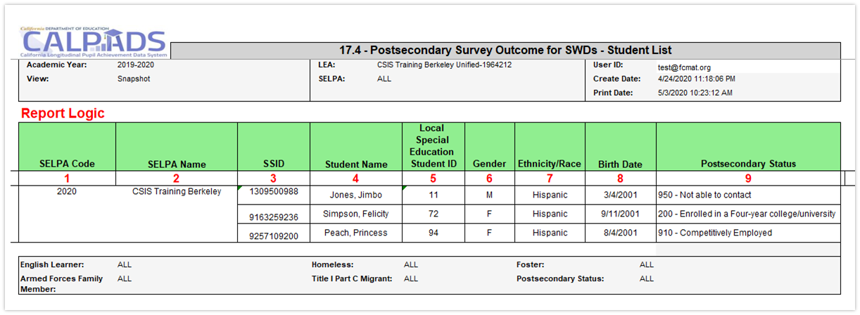
Postsecondary Status Data Analysis
Supporting Report 17.4 will list SWD and their postsecondary outcomes. Detail data is often found in supporting reports, data coordinators should ensure that the proper report is reviewed early in the submission window so there is time to reconcile data

Slide 26

Restraint And Seclusion
The Special Education Division use certified Restraint and Seclusion data when making its annual monitoring determinations:
LEAs reporting more than 2:1 ratio of restraints or seclusion per pupil will be asked to perform student record reviews
LEAs that :
Report zero incidents of restraint or seclusion and have greater than 100 students with disabilities; or
Report zero incidents of restraint or seclusion and have greater than 100 students with disabilities enrolled at Nonpublic Nonsectarian Certified Schools (NPS); or
Fail to certify the CALPADS EOY 1 submission
will be flagged for questionable data quality and will have to complete monitoring activities associated with data quality

Slide 27
SWD Enrollments
Age | Enrollment Status | Enrollment Start Date | Grade Level | School of Enrollment
Zero to 35 months | 50 – Non- ADA Enrollment | Date of parental consent for Part C initial evaluation | IN - Infant | District-level enrollment
3 to 5 years, public preschool OR private preschool serving preschoolers only (served by district on IEP) | 10 - Primary | Date of child’s third birthday for infants turning 3, otherwise Parent Consent Date | PS - Preschool | Preschool with specific CDS code – Enroll at preschool If no specific preschool CDS Code - District-level enrollment
3 to 5 years, private preschool additionally serving grades TK and higher (served by private school on ISP) | 50 – Non-ADA Enrollment | Date of parental consent | PS - Preschool | School 0000002 – Private School Group
5-21, Kindergarten (inc. TK) through 12 (public) | 10 - Primary | First day of enrollment | K-12 – Kindergarten through 12 | School of enrollment
5-21, Kindergarten (inc. TK) through 12 (private) | 50 – Non- ADA Enrollment | Date of parental consent | K-12 – Kindergarten through 12 | School 0000002 – Private School Group

Slide 28
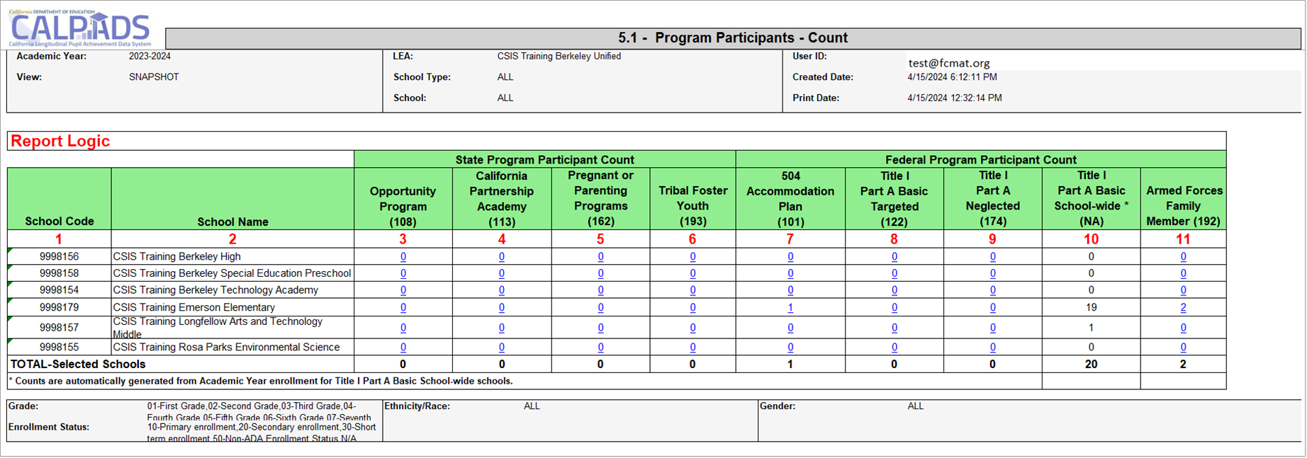
Early Program Counts –Report 5.1

Slide 29
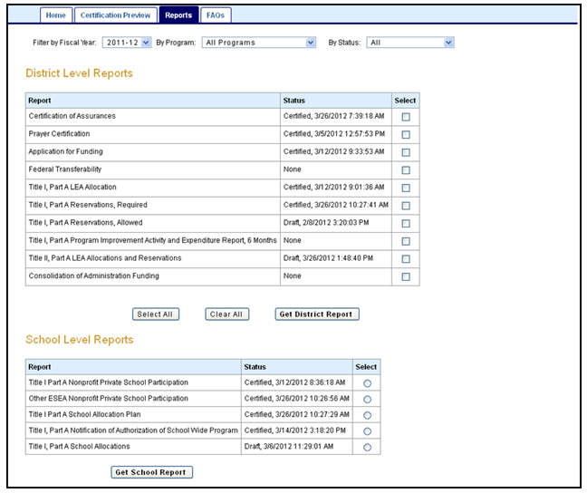
Pain Points Consolidated Application and Reporting System
A local education agency (LEA) that receives Title I, Part A funds operates one of two programs:
Targeted assistance school (TAS) program,
Must identify and submit student program records
or
Schoolwide program (SWP)
Not required to identify individual students or submit records
To be identified in CALPADS, schools operating schoolwide programs must be CERTIFIED in CARS
https://www.cde.ca.gov/fg/aa/co/cars.asp

Slide 30
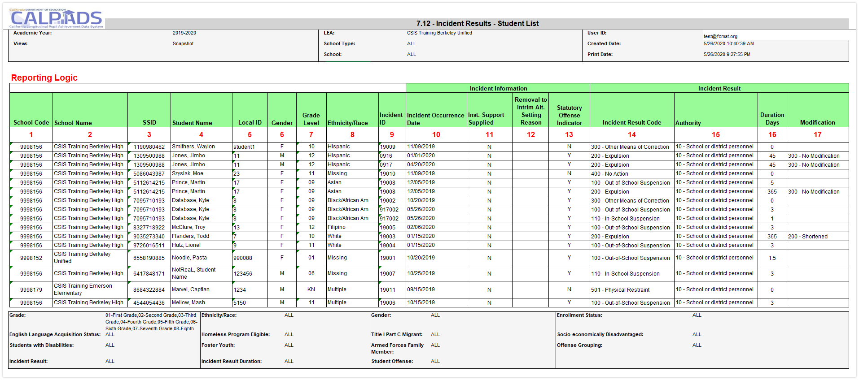
Identify which Report Provides Pertinent Information
Report 7.12 can be used to count individual suspensions and expulsions as well as other results

Slide 31
EOY 1 Reports
Report 7.10
Report 7.12
Incident Count
Incident Results - Student List
Report 1.21
Report 8.1 (EOY )
Cumulative Enrollment – Count
Student Profile - List (EOY)
Report 7.11
Incident Result – Count
Legend
Report 2.17
ELA Status – ELs Reclassified RFEP Student
Report 2.16
ELA Status – ELs Reclassified RFEP
Aggregate Report
Supporting Report
Report 7.13
Report 7.14
Student Offense - Count by Offense
Incident Offense– Student List
Report 5.4
Report 5.5
Homeless Students Enrolled - Unduplicated Count by School
Homeless Student List
Report 7.15
Incident Results- Persistently Dangerous Offense Expulsions
Report 7.16
Report 7.18
Incident Removals for Students with Disabilities – Count
Incident Removals for Students with Disabilities – Student List
Report 14.1
Report 14.2
Student Absenteeism - Count
Student Absences – Student List
Report 7.17
Unilateral Removals for Students with Disabilities - Count

Slide 32
EOY 1 Reports Program Participation
Report 5.2
Program Participants - NCLB Title I Part A Basic Targeted Education Services
Legend
Aggregate Report
Supporting Report
Report 5.1
Program Participant -Count
Report 5.3
Program Participants - Count

Slide 33
EOY 1 Reports Students with disabilities
Report 16.12
Students with Disabilities - Education Plan By Primary Disability Count (EOY)
Report 16.14
Students with Disabilities Plan –Student List (EOY)
Legend
Report 16.27
Students with Disabilities-Completer and Dropout Count
Aggregate Report
Supporting Report
Report 16.22
Report 16.23
Students with Disabilities –Special Ed Status and Non-Participant Reason Count
Students with Disabilities - Special Ed Status and Non-Participant Reason Student List
Report 16.28
Students with Disabilities – Completer and Dropouts Student List
Report 17.3
Report 17.4
Postsecondary Survey Outcome for SWDs-Count
Postsecondary Survey Outcomes for SWDs- Student List

Slide 34
EOY 1 Reports (NEW) –Expanded Learning Programs
Legend
Aggregate Report
Supporting Report
Report 19.1
Expanded Learning -Count
Report 19.2
Expanded Learning Program Participants-Student List

Slide 35
Suggested Milestones - EOY 1 - 2025-2026
Now – 5/5
Complete Data Population in local SIS
Now – 6/12
Submit and post files. Review IVR and Data Discrepancy errors and reconcile as needed.
6/15 – 6/26
Resolve Certification and Data Discrepancy errors. Review snapshot reports and update records as needed
0
6/26
Recommended Date for Zero Errors
Jun 26, 2026
Recommended date for zero errors
6/29– 7/10
Send reports to local data stewards, site leaders and administrators for approval (Send earlier if possible)
7/13 – 7/17
LEA Approve by Certification Deadline
(Should be SELPA Approved if possible)
Amendment Deadline
(SELPA Approval Required)
7/18 – 7/31

Slide 36

Fall 2 Is Over, Now What?
Resolve common/ frequently occurring errors
SENR0606E1–Missing Plan Record for Enrolled Eligible and Participating Student with Disabilities
PLAN0620E1-Missing Eligible and Participating Status Record for a Plan record
PLAN0673E1-Missing SWDS Record for a student with a PLAN record
Use Monitoring Report 16.21 to monitor timelines
Account for SWD completers
Graduates (Alternate Pathways)
Certificate of completion

Slide 37

EOY 1 Training
CALPADS User Manual
EOY Road Map
Student Programs
CSIS YouTube Training Channel
Student Program (SPRG) Data Population
End of Year (EOY) Trainings
Other Information
CALPADS Data Guide v11.0
Section 2.1.3 Student program

Slide 38

Available EOY 1 Training
CALPADS User Manual
EOY Road Map
Student Programs
Student Absence Summary
Incident
Reclassified EL
Student Program
Student Enrollment
Other Information
Relevant FAQ
CALPADS Update Flash #295 (Homeless)
CALPADS Update Flash #277 (RFEP)
Incident Data Collection from Nonpublic Nonsectarian Certified Schools in the California Longitudinal Pupil Achievement Data System
CSIS YouTube Training Channel
End of Year (EOY) Data Population Trainings
End of Year (EOY) Reporting & Certification Trainings

Slide 39

Available EOY 1 Training
CALPADS User Manual
Students with Disabilities Status (SWDS)
Special Education Plan (PLAN)
Special Education Meetings (MEET)
Special Education Services (SERV)
Postsecondary Status
CDE Guidance
Reporting Data for Students with Disabilities
Special Education File Submission Scenarios
Special Education Data FAQs
Appropriate SWDS Status and NonPart Reason for Student Exit Categories and Completion Statuses.xlsx
CSIS YouTube Training Channel
CALPADS Special Education Roadshow 2025
Creating and Maintaining Statewide Student Identifiers for Students with Disabilities in CALPADS

Slide 40

EOY 2
Course Completion, Career Technical Education, Work-based Learning preparation, Graduates and Completers

Slide 41
EOY 2 Data Collection
Data Submitted
Student Enrollment (SENR)
Files Submitted
Course Completion (CRSC)
Student Crs. Completion (SCSC)
Student CTE (SCTE)
Work-based Learning (WBLR)
Staff Demographics (SDEM)
Graduates and Completers (SENR)
Course Completions
Work Based learning
Career Technical Education
Perkins
CCI
CCI
Perkins
CCI
One Year Grads & Completer
DASS
Site Staff
Staff Involved with Submission
Registrars
Program staff
CTE
Site Administrators
Student System Support Staff

Slide 42
EOY 2 Pre-snapshot Submission Activities
Record Type | Activity | Reasoning | Processing Method | Record Operation Keys
SENR | Ongoing | Enrollment records should be updated with student movement | Transaction | School of Attendance SSID Enrollment Start Date
SDEM | Now | Teachers already in master schedule and assigned to courses | Transaction | Reporting LEA SEID
CRSC | Now | Course records for entire AY in master schedule | Replacement | School of Course Delivery Academic Year ID Academic Term Code
SCSC | Submit all completed grading periods* | Students have or nearly completed ¾ quarters, 1 of 2 semesters 2/3 trimesters GRADES are Available Now | Replacement | SSID School of Course Delivery Academic Year ID Academic Term Code Marking Period Code (For SCSC ONLY)
SCTE | Submit after SCSC is complete | CTE completers must have a capstone course in a corresponding pathway reported in the SCSC | Replacement | School of Attendance Academic Year ID
WBLR | Can Submit a test file | Likely that students are still earning WBLR hours | Replacement | School of Attendance Academic Year ID

Slide 43
CCI Course Completion
CCI Measure | Field Number in CALPADS | Starting in 2019–2020
College Credit Courses | 9.07 | CALPADS Field #9.07 (CRS-State Course Code) is used CCI College Credit Courses. Starting in 2019–2020, the following codes are used for Academic College Credit Courses: • 9020: College Credit Course – Visual Arts • 9082: College Credit Course – Dance • 9096: College Credit Course – Theatre • 9120: College Credit Course – English • 9154: College Credit Course – World Language
 |  | The 7000-8999 codes are used for CTE College Credit Courses Course Section Instructional Level Code [Field #9.19] of “23-College and Credit only” and “24 – Dual Credit” must be selected in conjunction with 7000-8999 codes to be counted CALPADS Data Field #10.18 (Student Course Final Grade): A+, A, A-, B+, B, B-, C+, C, C-, P (passing)
Leadership/ Military Science | 9.07 | For the current year, both of the following course codes are available for use to denote the completion of Leadership/ Military science: State Course Code 9373 – Leadership/Military Science (as of July 1, 2019) State Course Code 9374 – Junior Reserve Officers Training Corps (JROTC) (starting July 1, 2021)
• 9200: College Credit Course – History/Social Science
• 9227: College Credit Course – Other
• 9273: College Credit Course – Mathematics
• 9303: College Credit Course – Music
• 9358: College Credit Course – Science
43

Slide 44
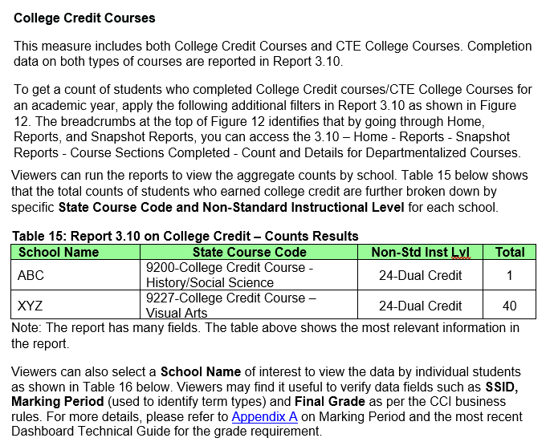
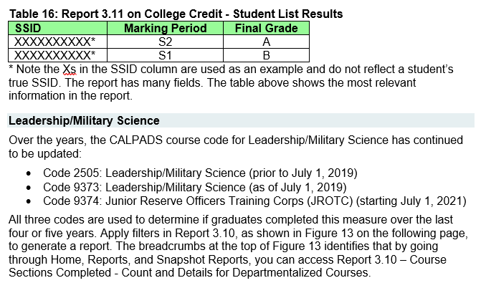
24-25 Handbook: Connecting CALPADS to the Dashboard
44

Slide 45
EOY 2 Certification Errors
Error #​ | Error Name​ | Severity​
CERT055​ | High school with No Enrollment in Career Technical Education​ | Warning​
SENR0687E2​ | No Student Course Section Data for a Secondarily or Short-Term Enrolled Student​ | Warning​
SCSC0681E2​ | Student Course Section for SSID Not Enrolled during Report Period​ | Fatal​
SENR0713E2​ | No Student Course Section Data for a Primarily Enrolled Student​ | Warning​
SENR0686E2​ | No Enrollment for Course Section (CRSC)​ | Warning​
CERT102​ | No CTE Completer Data​ | Warning​
SCTE0698E2​ | Missing or invalid SCSC record for CTE Completer ​ ​ | Fatal​
CERT169​ | No WBLR Data Submitted for a School​ | Warning​

Slide 46
EOY 2 CDD Errors cont.
Error #​ | Error Name​ | Severity​
SCSE0139E2​ | Missing Course Section Record​ | Fatal​
SCSC0140E2​ | Missing Student Credits Attempted​ | Fatal​
SCSC0141E2​ | Missing Student Credits Earned​ | Fatal​
SCSC0512E2​ | Missing Carnegie Units Earned​ | Fatal​
WBLR0576E2​ | SWDS record must exist for this Work-Based Learning Type​ | Fatal​

Slide 47
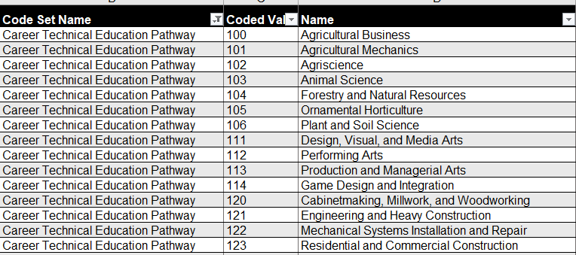
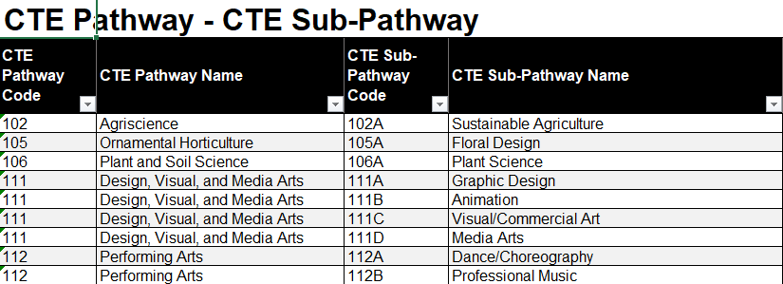
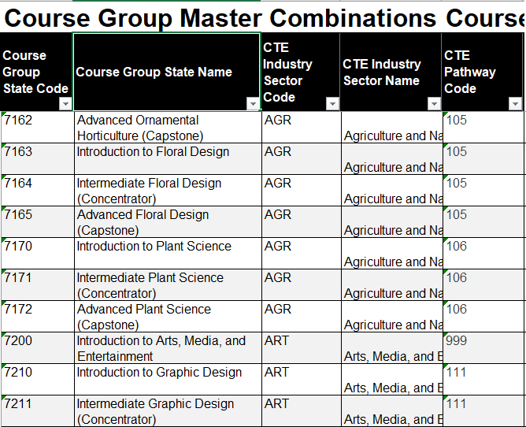
Pain Points CTE Pathway Mapping
SCTE0698E1 (CERT123)
At least one SCSC record with a Course Section ID at the same Reporting LEA for the student that is mapped to a CRS-State Course Code in a CRSC record that can then be mapped to the CTE Pathway specified for the student in the SCTE file and the SCSC record must have a Capstone Course Indicator = Yes.

Slide 48
Tracking Student WBLR Participation
Categorizing WBL Experiences
Identify opportunities and employers
Document dates, hours, performance
Preserve longitudinal records

Slide 49
Work-Based Learning vs Work Experience
Key Differences
 | Work-Based Learning | Work Experience
Focus | Educational approach, integrating learning with work | Broad term for any paid or unpaid work
Structure | Often structured, aligned with curriculum and industry standards | Can be structured or unstructured
Goal | To connect school experiences with real-life work activities and future careers | To gain practical skills, explore career paths, and develop employability skills
Examples | Internships, apprenticeships, job shadowing, school-based enterprises | Internships, volunteer work, part-time jobs, community service

Slide 50
EOY 2 Reports
Report 3.9
Report 3.10
Report 3.11
Course Sections Completed – Count by Content Area for Departmentalized Courses
Course Sections Completed – Count and Details for Departmentalized Courses
Course Sections Completed – Student List for Departmentalized Courses
Report 3.16
Educational Options Course Completion – Student Count
Report 3.14
Report 3.15
Career Technical Education Noncompleter Participants - Count
Career Technical Education Noncompleter Participants– Student List
Legend
Aggregate Report
Supporting Report
Report 3.19
Report 3.20
Report 1.22
Career Technical Education Completers – Count by Pathway
Career Technical Education Completers– Student List
Graduates and Completers – Count
Report 18.1
Report 18.2
Report 1.23
Work-Based Learning -Count
Work-Based Learning – Student List
Graduates and Completers –Student List

Slide 51
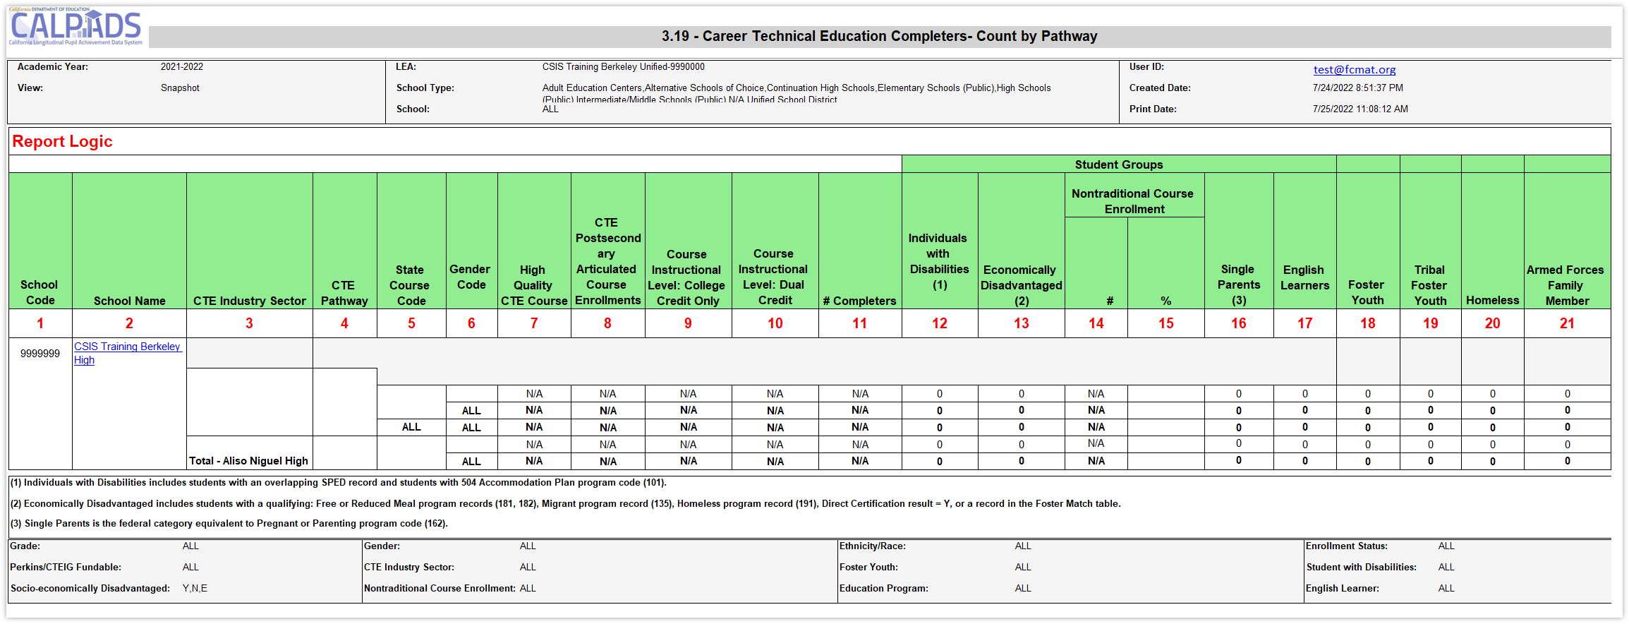
Identify Completers or Misaligned Pathways
Submit SCSC and SCTE files to estimate completer counts prior to EOY

Slide 52
Suggested Milestones - EOY 2 - 2025-2026
Now – 5/5
Complete Data Population in local SIS
Now – 7/3
Submit and post files. Review IVR and Data Discrepancy errors and reconcile as needed.
7/4 – 8/3
Resolve Certification and Data Discrepancy errors. Review snapshot reports and update records as needed
0
8/3
Recommended Date for Zero Errors
Aug 3, 2026
Recommended date for zero errors
8/4– 8/10
Send reports to local data stewards, site leaders and administrators for approval (Send earlier if possible)
8/11 – 8/17
LEA Approve by Certification Deadline
8/17
Final Deadline (No Amendment Window)

Slide 53

KEY Reminders EOY 1 & EOY 2
Additional CALPADS Activity

Slide 54

Be Mindful
Cohort Cutoff – 8/15/26​
Cohort Pull Date – 8/17/26 ​
Vacations? ​
Summer Grads still count so long as:​
Grad Date is on or before 8/15/25​
Posted in CALPADS on or before 8/15/25​
When does your summer school end?​
Still Enrolled students require their next AY (26-27) enrollment:​
Posted in CALPADS on or before 8/17/26​
Enrollment Start Date has to be before Census Day (10/7/26)​
When do you typically send up your SENR for the next school year?

Slide 55

CALPADS Work Continues
Regularly update student data in SIS and in CALPADS
Monitor SPED students’ meetings
Coordinate with business office on CARS certification
Prepare and Test students for:
Summative ELPAC
CAASPP
CAST
Stay current with training and Flash communications
Attend CALPADS Q&A
Attend SPED Office Hours
Vacation?
Notes:
As you know all too well, that CALPADS and data management can be an endless job. Even though we are in support of a healthy work life balance, we have to remind you that the CALPADS work continues. Here is a list of tasks that are current and ongoing.
Regularly update student data in SIS and in CALPADS
Monitor SPED students’ meetings
Coordinate with business office on CARS certification
Prepare and Test students for:
Summative ELPAC
CAASPP
CAST
Stay current with training and Flash communications
Attend CALPADS Q&A
Attend SPED Office Hours

Slide 56
CALPADS to TOMS
Nightly extraction from CALPADS
TOMS determines updates, deletions, and additions
LEAs review data uploaded to TOMS
Process continues through testing window
CALPADS sends the most current open primary and short-term enrollments (Enrollment Status = 10 or 30) for grades K-12
If a student is concurrently enrolled, CALPADS sends the enrollment with the most recent start date
Therefore, concurrent enrollments (CCEs) do not need to be resolved for a student to test unless the latter LEA enrolled the student in error
Updates in CALPADS on . . . | TOMS updated . . .
Thursday | Monday
Friday | Tuesday
Monday | Wednesday
Tuesday | Thursday
Wednesday | Friday

Slide 57
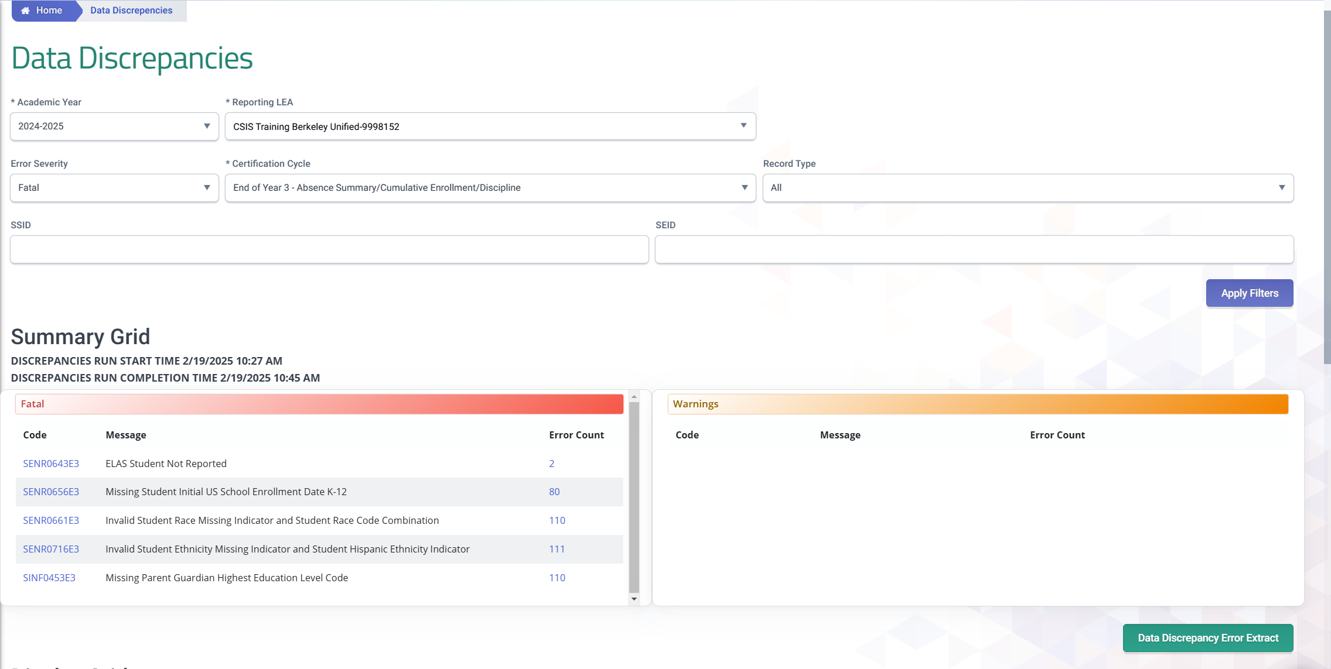
Data Discrepancies Dashboard
LEAs should take advantage of the CALPADS Data Discrepancies Dashboard to anticipate and correct potential CDDs without waiting for a new snapshot revision. DD refresh is quicker than the snapshot revision refresh.
Video Tutorial Resource https://documentation.calpads.org/DataDiscrepancies/DataDiscrepancies/

Slide 58
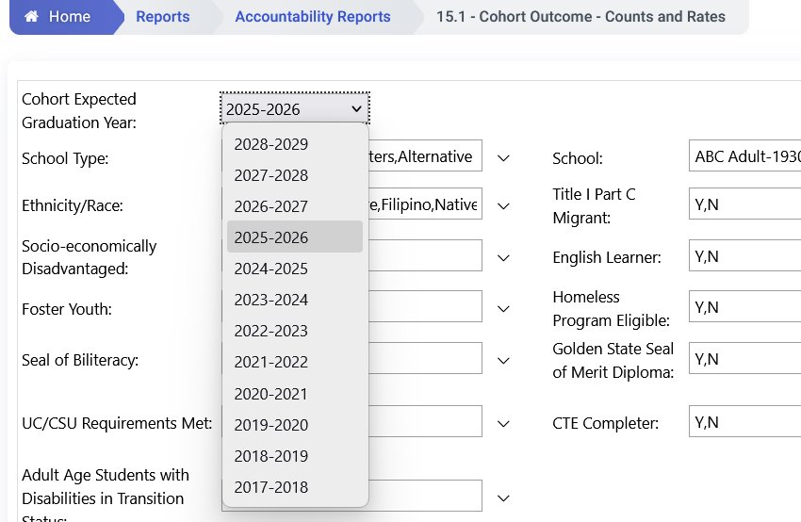
Cohort Reports
4 different cohort years to processing concurrently:
2025-2026
2026-2027
2027-2028
2028-2029
Reminder
Allow a user to select a future cohort year.
(Report 15.1 and 15.2)
Users can see their cohorts earlier and will be able to verify their first-time 9th grade records sooner.
Will be accessible continuously throughout the whole year
Anticipate students who may potentially be completers versus still enrolled.

Slide 59

Wrap Up
Key Points, Resources and Support

Slide 60
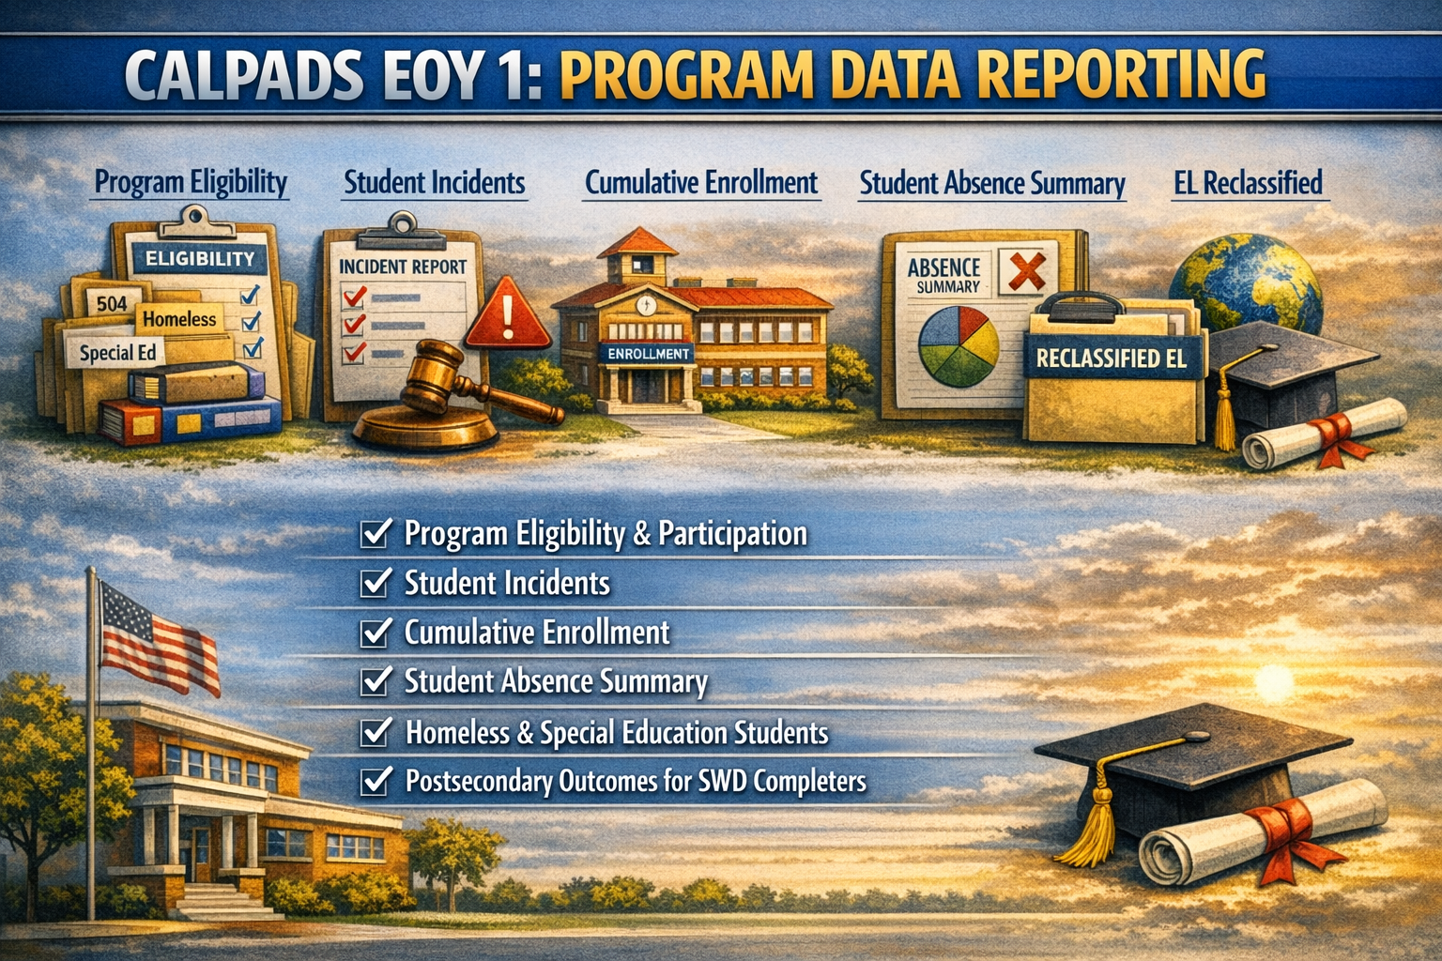
EOY 1 Summary
EOY 1 requires the SINC, SIRS, SOFF, STAS, SPRG, LEAP, SELA and SENR records be posted​
EOY 1 requires SELPA Approval​
The data in EOY is reflective of the entire academic year ​
Check CARS certification deadline.
​
CARS certification does not reflect immediately in CALPADS.​
Review 2024-2025 Summative Scores for Reclassification in 2025-2026
LEAs are required to submit incident data for students placed in Nonpublic Schools.
All homeless records must close out at end of year ​

Slide 61

EOY 2 Summary
EOY 2 requires the SDEM, CRSC, SCSC, SCTE, WBLR and SENR records be posted​
Course completion (CRSC) data is required for students in departmentalized classroom settings in grades 9–12 attending traditional schools. Optional for 7-8 grades ​
Grades, credits attempted, and credits earned are required for grade levels 9–12. ​
Submit student course completion (SCSC) data from all official grading periods for the school year​
LEAs identify CTE participants by submitting course completion (SCSC) data ​
SCTE records must only be submitted for CTE Pathway completers who finished the capstone course in the current academic year.​
EOY 1 and EOY 2 have different deadlines , No Amendment window for EOY 2
Some key points to remember

Slide 62

Future Training
CALPADS End-of-Year (EOY 1 & 2) Reporting & Certification training begins 4/23/2026
25-26 EOY Pre-Recorded Trainings are available now on CSIS YouTube Channel
May Regional Meetings 5/5/2026- 5/6/2026 –Register on CSIS Website

Slide 63

Available EOY 2 Training
CALPADS User Manual
EOY Road Map
Staff Demographics
Student Course Section
Student Career Technical Education
Work-based Learning
CSIS YouTube Training Channel
End of Year (EOY) Trainings
Other Information
CALPADS Update Flash #229 (WBLR)
SCTE FAQ
CTE FAQ
Course Completion FAQ

Slide 64


CALPADS Special Education Data Roadshows
4/13/2026 Merced​
4/14/2026 Madera​
4/15/2026 Tulare​
4/17/2026 Fresno​
4/20/2026 San Diego​
4/21/2026 Los Angeles COE​
4/22/2026 Ventura​
4/23/2026 Riverside​
4/24/2026 San Bernardino​
5/11/2026 Sacramento​
5/13/2026 Sonoma​
5/14/2026 San Joaquin​
5/15/2026 Shasta​
5/18/2026 Contra Costa​
5/19/2026 Santa Clara
Notes:
Dominic from the CDE SPED office will be traveling to COEs and SELPA throughout the spring providing information on the Upcoming EOY 4 submission to special education staff. Please check with your local county office or the CDE special education team for registration details.

Slide 65



Resources
Here are some important resources related to CALPADS reporting.
https://csis.fcmat.org/csis-training
https://www.youtube.com/channel/UCA9oRTiyVECCCzOxpmJheZw
https://documentation.calpads.org/Support/References
https://www.cde.ca.gov/ds/sp/cl/systemdocs.asp

Slide 66

Support
http://www2.cde.ca.gov/calpadshelp/default.aspx
Web
calpads-support@cde.ca.gov
Email
916-325-9210
Phone
https://csis.fcmat.org/ListServ
https://www.cde.ca.gov/ds/sp/cl/listservs.asp
You can get help through these channels.
Listserv

Slide 67

Thank You
CSIS Training
+1 916 325 9210
csistraining@fcmat.org
https://csis.fcmat.org/

